Slide 1
CHAPTER The Partial Equilibrium
12 Competitive Model

Slide 2
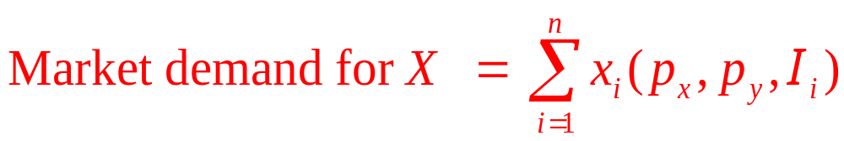
Market Demand
Only two goods (x and y)
  An individual’s demand for x is
Quantity of x demanded = x(p_{x},p_{y},I)
  If we use i to reflect each individual in the market

Slide 3
Market Demand Curve
Market demand curve for good X
  p_{X} is allowed to vary
  p_{y} and the income of each individual are held constant
  If each individual’s demand for x is downward sloping, the market demand curve will also be downward sloping

Slide 4
12.1 Construction of a Market Demand Curve from Individual Demand Curves
(a) Individual 1
(b) Individual 2
(c) Market demand
p_{x}
p_{x}
p_{x}
p_{x}*
x₁
x₂
X
x₁*
x₁
x₂*
x₂
x*
X
A market demand curve is the ‘‘horizontal sum’’ of each individual’s demand curve. At each price the quantity demanded in the market is the sum of the amounts each individual demands. For example, at p*_{x} the demand in the market is x*₁+x*₂ = X*

Slide 5
Shifts in the Market Demand Curve
The market demand
  Summarizes the ceteris paribus relationship between X and p_{x}
  Changes in p_{x} result in movements along the curve (change in quantity demanded)
  Changes in other determinants of the demand for X cause the demand curve to shift to a new position (change in demand)

Slide 6
12.1 Shifts in Market Demand
Suppose that individual 1’s demand for oranges is given by: x₁ = 10 – 2p_{x} + 0.1I₁ + 0.5p_{y}
  p_{x} = price of oranges
  I₁ = individual’s 1 income
  p_{y} = price of grapefruit
and individual 2’s demand for oranges is
x₂ = 17 – p_{x} + 0.05I₂ + 0.5p_{y}
The market demand curve is
X (p_{x}, p_{y}, I₁, I₂) = x₁ + x₂ = 27 – 3p_{x} + 0.1I₁ + 0.05I₂ + p_{y}

Slide 7
12.1 Shifts in Market Demand
If p_{y} = 4, I₁ = 40, and I₂ = 20, the market demand curve becomes:
X = 27 – 3p_{x} + 4 + 1 + 4 = 36 – 3p_{x}
If p_{y} rises to 6, the market demand curve shifts outward to: X = 27 – 3p_{x} + 4 + 1 + 6 = 38 – 3p_{x}
  Note that X and Y are substitutes
If I₁ fell to 30 while I₂ rose to 30, the market demand would shift inward to
X = 27 – 3p_{x} + 3 + 1.5 + 4 = 35.5 – 3p_{x}
  Note that X is a normal good for both buyers

Slide 8
Generalizations
Suppose that there are n goods
  x_{i}, i = 1,n
  With prices p_{i}, i = 1,n
Assume that there are m individuals in the economy
  The j th’s demand for the i th good will depend on all prices and on I_{j}
x_{i,j} = x_{i,j}(p₁,…,p_{n}, I_{j})

Slide 9
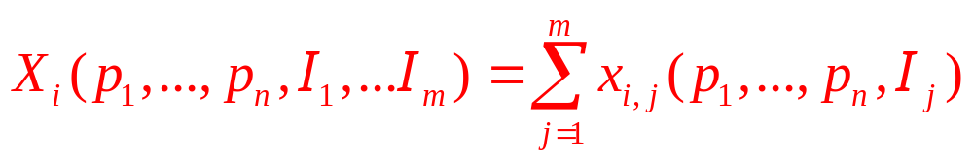
Generalizations
The market demand function for x_{i}
  Sum of each individual’s demand for that good
The market demand function depends on the prices of all goods and the incomes and preferences of all buyers

Slide 10
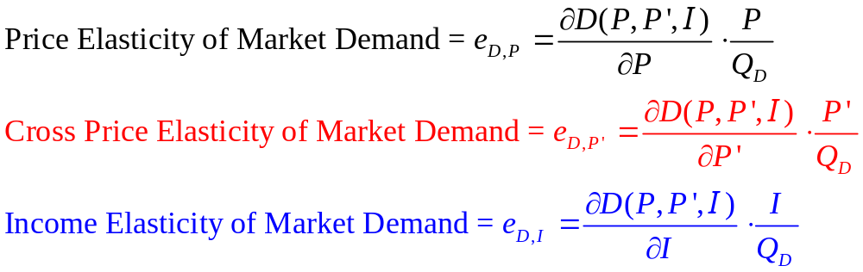
Elasticity of Market Demand
The market demand function: Q_{D} = D(P,P’,I)
Define elasticities:
  Elastic demand: e_{D,P} < -1; Unit elastic: e_{D,P} = -1
  Inelastic demand 0 ≥ e_{D,P} > -1

Slide 11
Timing of the Supply Response
Time period
  Very short run
    No supply response (quantity supplied is fixed)
  Short run
    Existing firms can alter their quantity supplied, but no new firms can enter the industry
  Long run
    New firms may enter an industry

Slide 12
Pricing in the Very Short Run
Very short run / the market period
  There is no supply response to changing market conditions
  Price acts only as a device to ration demand
    Price will adjust to clear the market
  The supply curve is a vertical line

Slide 13
12.2 Pricing in the Very Short Run
Price
D’
S
D
P₂
P₁
D’
D
S
Quantity per period
Q*
When quantity is fixed in the very short run, price acts only as a device to ration demand. With quantity fixed at Q*, price P₁ will prevail in the marketplace if D is the market demand curve; at this price, individuals are willing to consume exactly that quantity available. If demand should shift upward to D’, the equilibrium market price would increase to P₂.

Slide 14
Short-Run Price Determination
In the short-run
  The number of firms in an industry is fixed
  These firms are able to adjust the quantity they are producing
    They can do this by altering the levels of the variable inputs they employ

Slide 15
Perfect Competition
A perfectly competitive industry:
  There are a large number of firms, each producing the same homogeneous product
  Each firm attempts to maximize profits
  Each firm is a price taker: its actions have no effect on the market price
  Information is perfect: prices are assumed to be known by all market participants
  Transactions are costless: Buyers and sellers incur no costs in making exchanges

Slide 16
Short-Run Market Supply
Quantity of output supplied
  To the entire market in the short run
  Is the sum of the quantities supplied by each firm
    The amount supplied by each firm depends on price
Short-run market supply curve
  Upward-sloping: each firm’s short-run supply curve has a positive slope

Slide 17
12.3 Short-Run Market Supply Curve
(a) Firm A
(b) Firm B
(c) The market
P
S_{A}
P
S_{B}
S
P
P₁
q₁^{A}
q^{A}
q₁^{B}
q^{B}
Q₁
Total
output
per period
The supply (marginal cost) curves of two firms are shown in (a) and (b). The market supply curve (c) is the horizontal sum of these curves. For example, at P₁ firm A supplies q^{A}₁, firm B supplies q^{B}₁, and total market supply is given by Q₁ = q^{A}₁ + q^{B}₁.

Slide 18
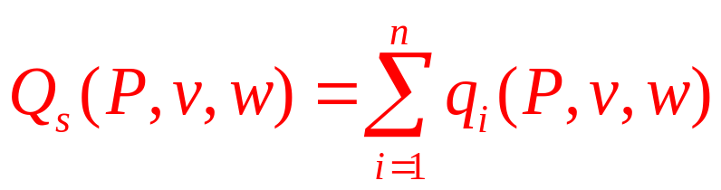
Short-Run Market Supply Function
Short-run market supply function
  Shows total quantity supplied by each firm to a market
  Firms are assumed to face the same market price and the same prices for inputs

Slide 19
Short-Run Market Supply Function
Short-run market supply curve
  Shows the two-dimensional relationship between Q and P
  Holding v and w (and each firm’s underlying technology) constant
  If v, w, or technology were to change, the supply curve would shift

Slide 20
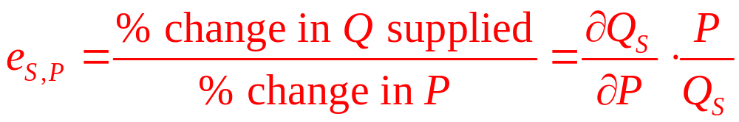
Short-Run Supply Elasticity
Short-run supply elasticity
  Describes the responsiveness of quantity supplied to changes in market price
  Because price and quantity supplied are positively related, e_{S,P} > 0

Slide 21
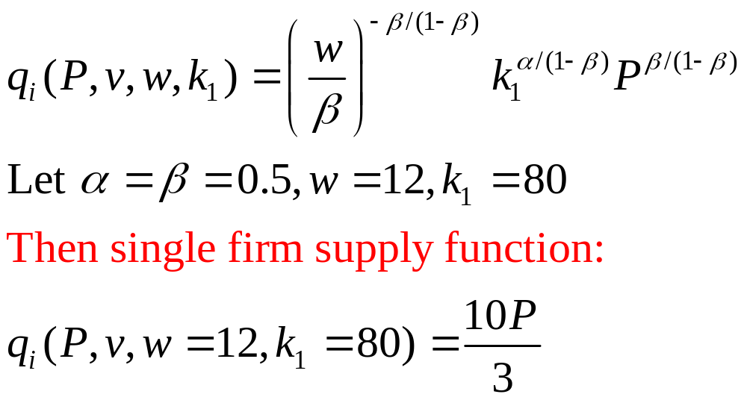
12.2 A Short-Run Supply Function
Cobb-Douglas production function:

Slide 22
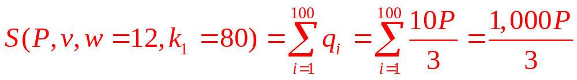
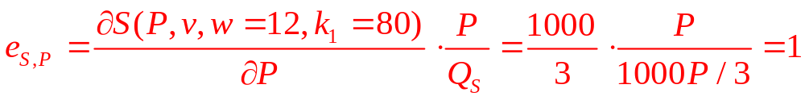
12.2 A Short-Run Supply Function
100 identical firms
  Each with the same short-run supply function
Short-run market supply function:
Short-run elasticity of supply:

Slide 23
Equilibrium Price Determination
Equilibrium price
  Is one at which quantity demanded is equal to quantity supplied
  Neither suppliers nor demanders have an incentive to alter their economic decisions
  An equilibrium price (P*) solves the equation:
D(P*,P’,I) = S (P*,w,v)
or: D(P*) = S (P*)

Slide 24
12.4 Interactions of Many Individuals and Firms
Determine Market Price in the Short Run
(a) A typical firm
S
SMC
(b) The market
(c) A typical individual
P
P
P
SAC
P₂
P₁
D’
d’
D
d
Q
demanded
per period
q₁
q₂
Output
per period
Q₁
Q₂
Total output
per period
q₁
q₂
q’₁
Market demand curves and market supply curves are each the horizontal sum of numerous components. These market curves are shown in (b). Once price is determined in the market, each firm and each individual treat this price as a fixed parameter in their decisions. Although individual firms and persons are important in determining price, their interaction as a whole is the sole determinant of price. This is illustrated by a shift in an individual’s demand curve to d’. If only one individual reacts in this way, market price will not be affected. However, if everyone exhibits an increased demand, market demand will shift to D’; in the short run, price will increase to P₂.

Slide 25
Shifts in Supply and Demand Curves
Demand curves shift because
  Incomes change
  Prices of substitutes or complements change
  Preferences change
Supply curves shift because
  Input prices change
  Technology changes
  Number of producers change

Slide 26
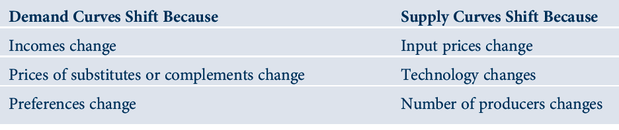
12.1 Reasons for Shifts in Demand or Supply
Curves

Slide 27
Shifts in Supply and Demand Curves
When either a supply curve or a demand curve shift
  Equilibrium price and quantity will change
  The relative magnitudes of these changes depends on the shapes of the supply and demand curves

Slide 28
12.5 Effect of a Shift in the Short-Run S Curve
Depends on the Shape of the D Curve
Price
S’
S’
S
Price
S
P’
P’
P
P
D
D
Q’
Q
Q per
period
Q’
Q
Q per
period
(a) Elastic Demand
(b) Inelastic Demand
In (a) the shift upward in the supply curve causes price to increase only slightly while quantity decreases sharply. This results from the elastic shape of the demand curve.
In (b) the demand curve is inelastic; price increases substantially, with only a slight decrease in quantity.

Slide 29
12.6 Effect of a Shift in the D Curve Depends on the Shape of the Short-Run Supply Curve
S
Price
Price
S
P’
P’
P
P
D’
D’
D
D
Q
Q’
Q per
period
Q
Q’
Q per
period
(a) Elastic Supply
(b) Inelastic Supply
In (a), supply is inelastic; a shift in demand causes price to increase greatly, with only a small concomitant increase in quantity.
In (b), on the other hand, supply is elastic; price increases only slightly in response to a demand shift.

Slide 30
A Comparative Statics Model of Market Equilibrium
Demand function, Q_{D} = D(P,α)
  α - exogenous variable that shifts the demand function
Supply function, Q_{S} = S(P,β)
  β - exogenous variable that shifts the supply function
Market equilibrium (P* and Q*) are determined: Q_{D} = Q_{S} = Q* = D(P*,α) = S(P*,β)

Slide 31
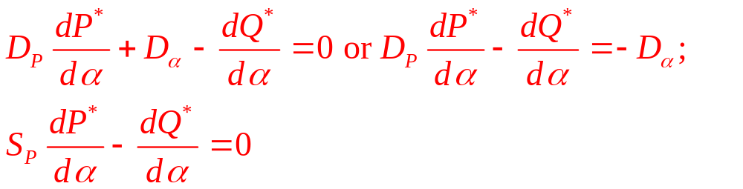
A Comparative Statics Model of Market Equilibrium
Equilibrium conditions:
D(P*,α) – Q* = 0
S(P*,β) – Q* = 0
Differentiate with respect to α:

Slide 32
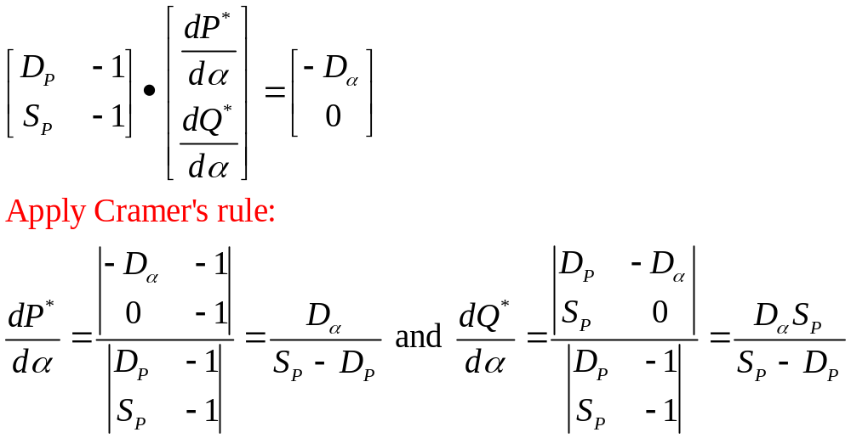
A Comparative Statics Model of Market Equilibrium
In matrix notation:
  Because S_{P}>0, D_{P}<0 , the denominators of these expressions will be positive.
  Hence the overall sign of dP*/dα and dQ*/dα will both have the same sign as that of D_{α}

Slide 33
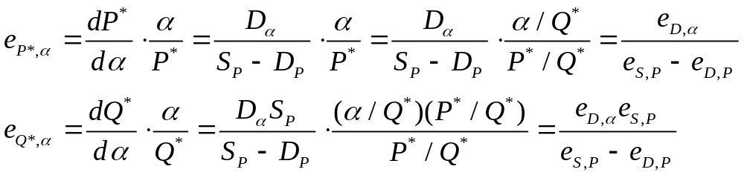
A Comparative Statics Model of Market Equilibrium
An elasticity interpretation:
  Elastic supply (e_{S,P}>1): proportional increase in equilibrium quantity > proportional increase in price
  Inelastic supply (e_{S,P}<1): proportional increase in equilibrium quantity < proportional increase in price

Slide 34
12.3 Equilibria with Constant Elasticity Functions
Demand and supply for automobiles:
Q_{D}(P,I) = 0.1P^{-1.2}I³ and Q_{S}(P,w) = 6,400Pw^{-0.5}
If I = $20,000 and w = $25, demand-supply equilibrium:
Q_{D} = 0.1P^{-1.2}I³ = (8×10¹¹) P^{-1.2} = Q_{S} = 6,400Pw^{-0.5} = 1,280P
  Equilibrium: P* = 9,957 and Q* = 12,745,000

Slide 35
12.3 Equilibria with Constant Elasticity Functions
A 10 percent increase in real family income would shift the demand curve:
Q_{D} = (1.06×10¹²) P^{-1.2}
  Equilibrium: P* = 11,339 and Q* = 14,514,000
If wages were to increase from $25 to $30 per hour, the supply function would shift:
Q_{S} = 6,400P(30)^{-0.5} = 1,168P
  Equilibrium: P* = 10,381 and Q* = 12,125,000

Slide 36
Long-Run Analysis
Long run
  A firm may adapt all of its inputs to fit market conditions
  Profit-maximization for a price-taking firm:
    Price is equal to long-run MC
  Firms can also enter and exit an industry
  Perfect competition: there are no special costs of entering or exiting an industry

Slide 37
Long-Run Analysis
New firms will be lured into any market
  Where economic profits are > 0
    The short-run industry supply curve will shift outward
    Market price and profits will fall
    The process will continue until economic profits are zero

Slide 38
Long-Run Analysis
Existing firms will leave any industry
  Where economic profits are negative
    The short-run industry supply curve will shift inward
    Market price will rise and losses will fall
    The process will continue until economic profits are zero

Slide 39
Long-Run Competitive Equilibrium
Assumptions
  All firms in an industry have identical cost curves
    No firm controls any special resources or technology
  The equilibrium long-run position requires that each firm earn zero economic profit
    P = MC (profit maximization)
    P = AC (zero profit)

Slide 40
Long-Run Competitive Equilibrium
A perfectly competitive industry is in long-run equilibrium
  If there are no incentives for profit-maximizing firms to enter or to leave the industry
  When the number of firms is such that
    P = MC = AC
    And each firm operates at minimum AC

Slide 41
Long-Run Equilibrium: Constant-Cost Case
Constant-cost industry
  The entry of new firms in an industry has no effect on the cost of inputs
    No matter how many firms enter or leave an industry, a firm’s cost curves will remain unchanged

Slide 42
12.7 Long-Run Equilibrium for a Perfectly
Competitive Industry: Constant Cost Case
Price
MC
Price
S
SMC
S’
AC
P₂
P₁
LS
D’
D
q₁
q₂
Quantity
per period
Q₁
Q₂
Q₃
Quantity
per period
(a) A Typical Firm
(b) Total Market
An increase in demand from D to D’ will cause price to increase from P₁ to P₂ in the short run.
This higher price will create profits in the industry, and new firms will be drawn into the market. If it is assumed that the entry of these new firms has no effect on the cost curves of the firms in the industry, then new firms will continue to enter until price is pushed back down to P₁.
At this price, economic profits are zero. Therefore, the long-run supply curve (LS) will be a horizontal line at P₁. Along LS, output is increased by increasing the number of firms, each producing q₁.

Slide 43
12.4 Infinitely Elastic Long-Run Supply
Total cost curve for a typical firm in the bicycle industry: C(q) = q³ – 20q² + 100q + 8,000
Demand for bicycles: Q_{D} = 2,500 – 3P
Long-run equilibrium
  Minimum point on the typical firm’s average cost curve: AC = MC
AC = q² – 20q + 100 + 8,000/q
MC = 3q² – 40q + 100
  So, q = 20
If q = 20, AC = MC = $500
  Long-run equilibrium price

Slide 44
Shape of the Long-Run Supply Curve
Shape of the long-run cost curve
  Determined by the zero-profit condition
  Horizontal - if average costs are constant as firms enter
  Upward sloped - if average costs rise as firms enter
  Negatively sloped - if average costs fall as firms enter

Slide 45
Long-Run Equilibrium:
Increasing-Cost Industry
The entry of new firms
  May cause the average costs of all firms to rise
  Prices of scarce inputs may rise
  New firms may impose “external” costs on existing firms
  New firms may increase the demand for tax-financed services

Slide 46
12.8 An Increasing Cost Industry Has a Positively
Sloped Long-Run Supply Curve
(a) Typical firm before entry
(b) Typical firm after entry
(c) The market
SMC
SMC
MC
S
S’
P
MC
P
AC
P
AC
LS
P₂
P₂
P₃
P₃
P₁
P₁
D’
D
q₁
q₂
Output
per period
q₃
Output
per period
Q₁
Q₂
Q₃
Output
per period
Initially the market is in equilibrium at P₁, Q₁.
An increase in demand (to D’) causes price to increase to P₂ in the short run, and the typical firm produces q₂ at a profit. This profit attracts new firms into the industry.
The entry of these new firms causes costs for a typical firm to increase to levels shown in (b).
With this new set of curves, equilibrium is re-established in the market at P₃, Q₃. By considering many possible demand shifts and connecting all the resulting equilibrium points, the long-run supply curve (LS) is traced out.

Slide 47
Long-Run Equilibrium:
Decreasing-Cost Industry
The entry of new firms
  May cause the average costs of all firms to fall
  New firms may attract a larger pool of trained labor
  Entry of new firms may provide a “critical mass” of industrialization
    Permits the development of more efficient transportation and communications networks

Slide 48
12.9 A Decreasing Cost Industry Has a Negatively
Sloped Long-Run Supply Curve
(a) Typical firm before entry
(b) Typical firm after entry
(c) The market
SMC
S
P
MC
P
P
D’
AC
SMC
D
P₂
MC
P₂
AC
S’
P₁
P₁
P₃
P₃
LS
q₁
q₂
Output
per period
q₃
Output
per period
Q₁
Q₂
Q₃
Output per period
Initially the market is in equilibrium at P₁, Q₁. An increase in demand (to D’) causes price to increase to P₂ in the short run, and the typical firm produces q₂ at a profit. This profit attracts new firms into the industry. If the entry of these new firms causes costs for the typical firm to decrease, a set of new cost curves might look like those in (b). With this new set of curves, market equilibrium is re-established at P3, Q₃. By connecting such points of equilibrium, a negatively sloped long-run supply curve (LS) is traced out.

Slide 49
Classification of Long-Run Supply Curves
Constant Cost
  Entry does not affect input costs
  Horizontal long-run supply curve at the long-run equilibrium price
Increasing Cost
  Entry increases inputs costs
  Positively sloped long-run supply curve
Decreasing Cost
  Entry reduces input costs
  Negatively sloped long-run supply curve

Slide 50
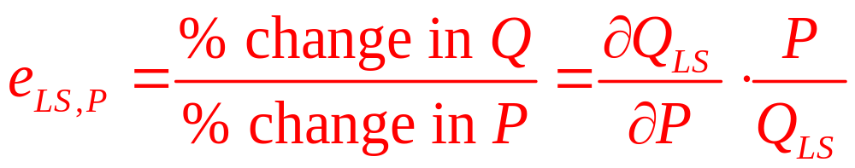
Long-Run Elasticity of Supply
Long-run elasticity of supply (e_{LS,P})
  Records the proportionate change in long-run industry output to a proportionate change in price
  Can be positive or negative
    The sign depends on whether the industry exhibits increasing or decreasing costs

Slide 51
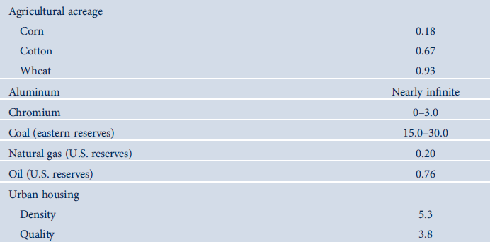
12.2 Selected estimates of long-run supply elasticities

Slide 52
Comparative Statics Analysis of Long Run Equilibrium
Assume: a constant-cost industry
  Initial long-run equilibrium
    Industry output is Q₀
    Typical firm’s output is q* (where AC is minimized)
    Equilibrium number of firms in the industry (n₀) is Q₀/q*

Slide 53
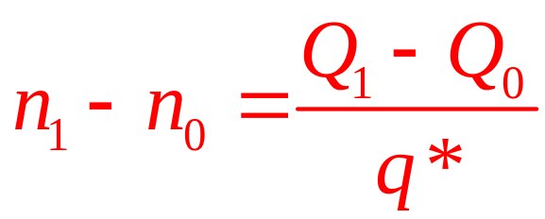
Comparative Statics Analysis of Long Run Equilibrium
A shift in demand
  That changes the equilibrium industry output to Q₁
  Changes the equilibrium number of firms to n₁ = Q₁/q*
  Change in the number of firms is

Slide 54
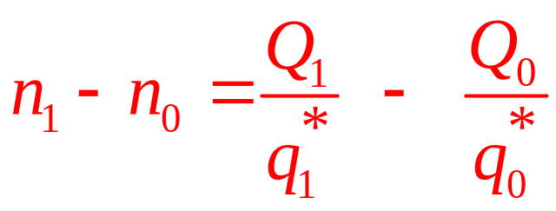
Comparative Statics Analysis of Long Run Equilibrium
The effect of a change in input costs
  More complicated
  Affects minimum average cost
  Affects the quantity demanded
  Affects the optimal level of output for each firm
  Change in the number of firms:

Slide 55
12.10 An Increase in an Input Price May Change
Long-Run Equilibrium Output for Typical Firm
AC₁
Price
MC₁
MC₀
AC₀
q*₀
q*₁
Quantity per period
An increase in the price of an input will shift average and marginal cost curves upward. The precise effect of these shifts on the typical firm’s optimal output level (q*) will depend on the relative magnitudes of the shifts.

Slide 56
12.5 Increasing Input Costs and Industry Structure
Total cost curve for a typical firm in the bicycle industry: C(q) = q³ – 20q² + 100q + 8,000
  Then rises to: C(q) = q³ – 20q² + 100q + 11,616
The optimal scale of each firm
  Rises from 20 to 22 (where MC = AC)
At q = 22
  MC = AC = $672 = Long-run equilibrium price
For demand: Q_{D} = 2,500 – 3P
  Q_{D} = 484
  Number of firms in the industry = 484 ÷ 22 = 22

Slide 57
Producer Surplus in the Long Run
Short-run producer surplus
  The return to a firm’s owners in excess of what would be earned if output was zero
  Sum of short-run profits and fixed costs
In the long-run
  All profits are zero and there are no fixed costs
  Owners are indifferent about whether they are in a particular market

Slide 58
Producer Surplus in the Long Run
Constant-cost industry
  Input prices are assumed to be independent of the level of production
  Inputs can earn the same amount in alternative occupations
Increasing-cost industry
  Entry will bid up some input prices
  Suppliers of these inputs will be made better off

Slide 59
Producer Surplus in the Long Run
Long-run producer surplus
  Extra return producers make by making transactions at the market price
    Over and above what they would earn if nothing were produced
  Area above the long-run supply curve and below the market price

Slide 60
Ricardian Rent
Many parcels of land
  Ranges from very fertile land (low costs of production) to very poor land (high costs)
Long-run supply curve for the crop
  At low prices only the best land is used
  As output increases, higher-cost plots of land are brought into production
  Positively sloped - increasing costs associated with using less fertile land

Slide 61
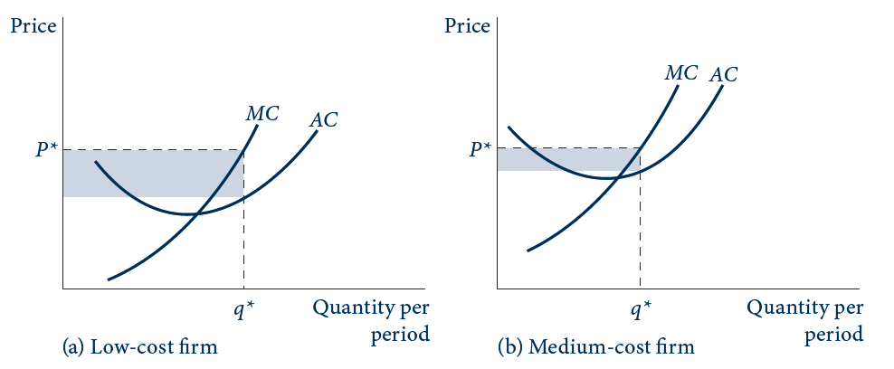
12.11 (a), (b) Ricardian Rent
Owners of low-cost and medium-cost land can earn long-run profits. Long-run producers’ surplus represents the sum of all these rents—area PEB in (d). Usually Ricardian rents will be capitalized into input prices.

Slide 62
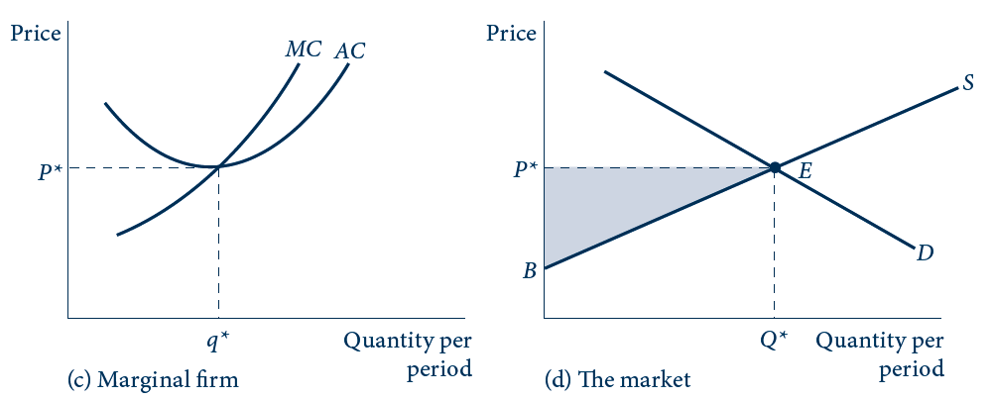
12.11 (c), (d) Ricardian Rent
Owners of low-cost and medium-cost land can earn long-run profits. Long-run producers’ surplus represents the sum of all these rents—area PEB in (d). Usually Ricardian rents will be capitalized into input prices.

Slide 63
Ricardian Rent
Firms with higher costs
  Will stay out of the market
  Would incur losses at a price of P*
Profits earned by intramarginal firms
  Can persist in the long run
  Reflect a return to a unique resource
Long-run producer surplus
  The sum of these long-run profits

Slide 64
Ricardian Rent
Long-run profits for the low-cost firms
  May be reflected in the prices of the unique resources owned by those firms
    The more fertile the land is, the higher its price
Profits are capitalized into inputs’ prices
  Reflect the present value of all future profits

Slide 65
Ricardian Rent
Scarcity of low-cost inputs
  Creates the possibility of Ricardian rent
Industries with upward-sloping long-run supply curves
  Increases in output
    Raise firms’ costs
    Generate factor rents for inputs

Slide 66
Economic Efficiency and Applied Welfare Analysis
Sum of consumer and producer surplus
  The area between the demand and the supply curve
  Measures the total additional value obtained by market participants by being able to make market transactions
  Maximized at the competitive market equilibrium

Slide 67
12.12 Competitive Equilibrium and Consumer/Producer
Surplus
Price
S
A
P₁
F
P *
E
P₂
G
B
D
Quantity per period
Q ₁
Q *
At the competitive equilibrium (Q*), the sum of consumer surplus (shaded lighter) and producer surplus (shaded darker) is maximized. For an output level Q₁ < Q*, there is a deadweight loss of consumer and producer surplus that is given by area FEG.

Slide 68
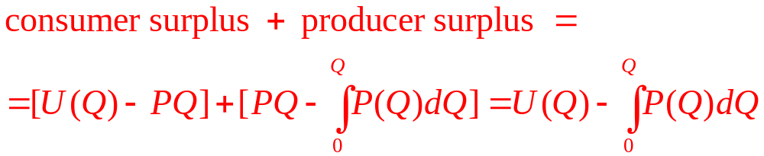
Economic Efficiency and Applied Welfare Analysis
Maximize total surplus:
  Long-run equilibria along the long-run supply curve: P(Q) = AC = MC
  Maximizing total surplus with respect to Q yields: U’(Q) = P(Q) = AC = MC
    Market equilibrium

Slide 69
12.6 Welfare Loss Computations
Demand and supply: Q_{D} = 10 – P; Q_{S} = P - 2
  Market equilibrium: P* = 6 and Q* = 4
  Restriction of output to Q=3
    Gap: P_{D} = 7, P_{S} = 5
    Welfare loss from restricting transactions = $1
Demand and supply: Q_{D} = 200P ^{-1.2}; Q_{S} = 1.3P
  Market equilibrium: P* = 9.87 and Q* = 12.8
  Restriction of output to Q=11
    Gap: P_{D} = 11.1, P_{S} = 8.46
    Welfare loss from restricting transactions = 2.4 (billion dollars)

Slide 70
Price Controls and Shortages
Governments - to control prices at below equilibrium levels
  Leads to a shortage
  Changes in producer and consumer surplus
    Impact on welfare

Slide 71
12.13 Price Controls and Shortages
A
SS
Price
P₂
C
E’
LS
P₃
P₁
E
D’
D
Quantity per period
Q₁
Q₃
Q₄
A shift in demand from D to D’ would increase price to P₂ in the short run. Entry over the long run would yield a final equilibrium of P₃, Q₃. Controlling the price at P₁ would prevent these actions and yield a shortage of Q₄ - Q₁. Relative to the uncontrolled situation, the price control yields a transfer from producers to consumers (area P₃CEP₁) and a deadweight loss of forgone transactions given by the two areas AE’C and CE’E.

Slide 72
Disequilibrium Behavior
Observed market outcomes are generated by
Q(P₁) = min [Q_{D}(P₁),Q_{S}(P₁)],
  Suppliers will be content with the outcome but demanders will not
  This could lead to a black market

Slide 73
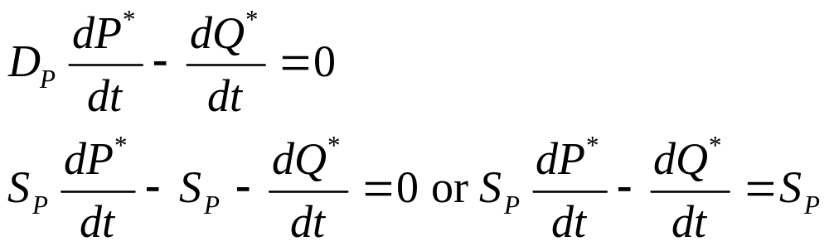
Tax Incidence Analysis
Per-unit tax (t)
  Creates a wedge between
    What demanders pay (P*)
    And what suppliers receive (P*-t)
  Equilibrium: D(P*) – Q*=0 and S(P*-t) – Q*=0
  Differentiate with respect to t

Slide 74
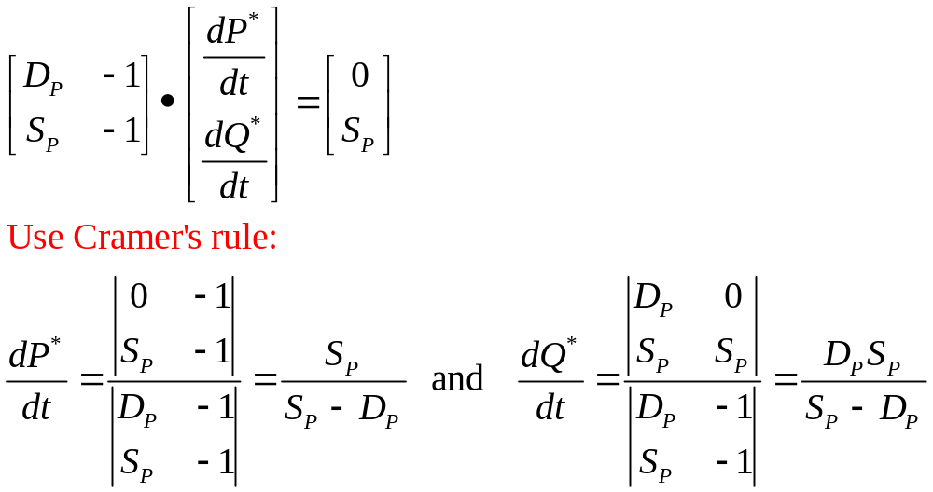
Tax Incidence Analysis
  In matrix notation:

Slide 75
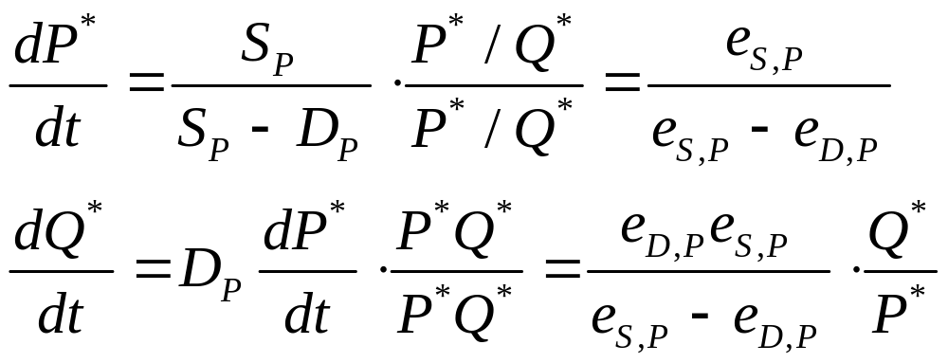
Tax Incidence Analysis
  In elasticity terms:
Imposition of the tax increases the price paid by demanders
    Except when e_{S,P} = 0
    Demanders pay all the tax when e_{D,P} = 0

Slide 76
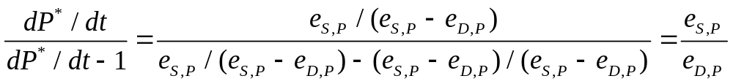
Tax Incidence Analysis
  How much of the burden of tax is imposed on demanders and on sellers:

Slide 77
Deadweight Loss and Elasticity
All non-lump-sum taxes
  Involve deadweight losses
  The size of the losses will depend on the elasticities of supply and demand
A linear approximation to the size of this deadweight loss for a small tax, t
DW = -0.5t² dQ/dt

Slide 78
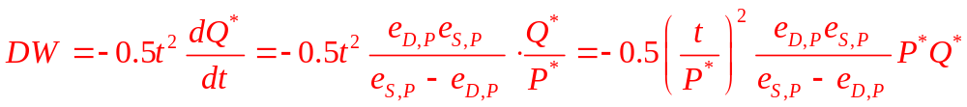
Deadweight Loss and Elasticity
Deadweight loss in elasticity terms:
  Is proportional to total spending on the good
    This proportion rises with the square of the tax as a proportion of the product’s price.
    At the marginal excess burden of a tax increases as the tax rate increases
    The lower the elasticities of supply and demand, the smaller is the excess burden

Slide 79
Transactions Costs
Transactions costs
  Can create a wedge between the price the buyer pays and the price the seller receives
If the transactions costs are on a per-unit basis
  They will be shared by the buyer and seller
    Depends on the specific elasticities involved

Slide 80
12.7 The Excess Burden of a Tax
From Example 12.6
  Equilibrium level of output = 12.8
A tax of $2,640
  New level of output = 11
With
  e_{D}= 1.2, e_{S} = 1.0, and initial spending = $126
  DW = 0.5(2.64/9.87)²(1.2/2.2)126 = 2.46

Slide 81
Demand aggregation and estimation
Market demand functions are continuous
  If individual demand functions are continuous or discontinuous
Market demand functions
  Are homogeneous of degree 0 in all prices and individual income
      Because each individual’s demand function is homogeneous of degree 0 in all prices and income
  Are not necessarily homogeneous of degree 0 in all prices and total income

Slide 82
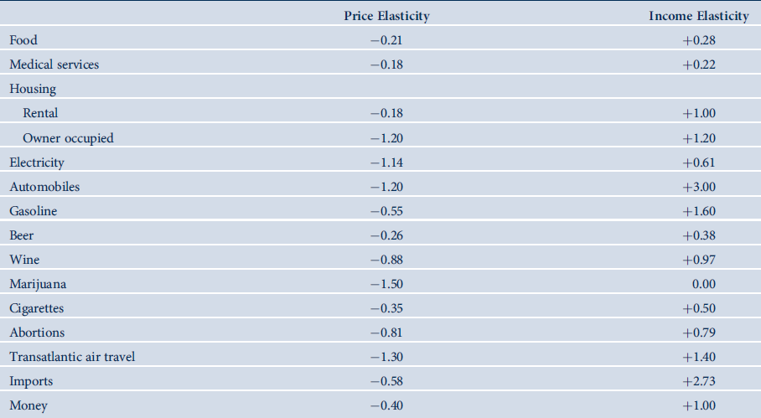
12.3 Representative Price and Income Elasticities of Demand

